Slide 1
Exploring Plain Vision Transformer Backbones for Object Detection
2022 Mar 30
鄧仲恩
NTUST GAMELab

Slide 2
Outline
Introduction
Related Work
Method
Experiments
Conclusion
NTUST GAMELab

Slide 3
Introduction
NTUST GAMELab

Slide 4
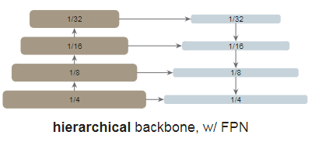
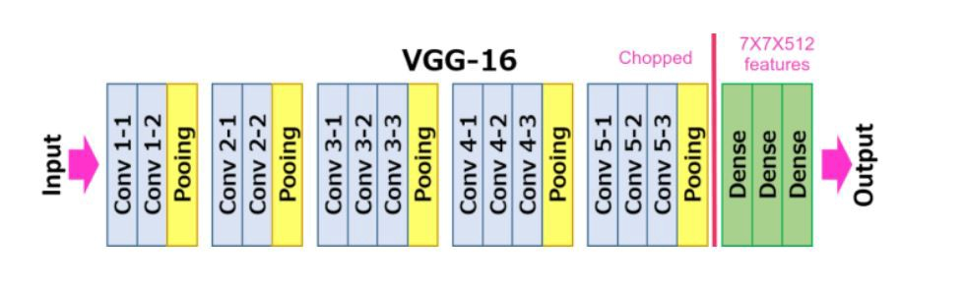
Introduction – Detection CNN base
Backbones
Neck
Head
VGG
ResNet
DarkNet
Region Proposal Networks (RPN)
Region-of-Interest (RoI)
Feature Pyramid Networks (FPN)
NTUST GAMELab
Notes:
ROI Pooling 統一anchor box 的尺度

Slide 5
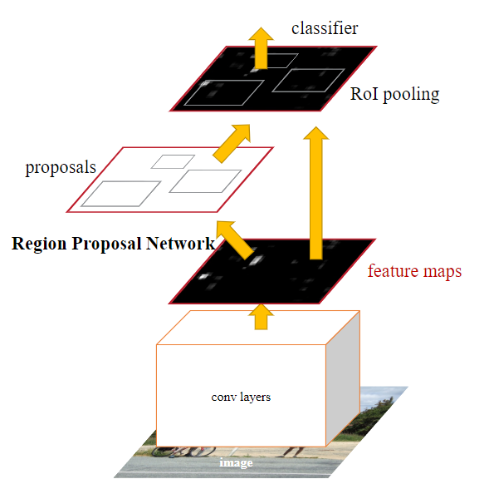
Introduction – Detection CNN base
NTUST GAMELab

Slide 6
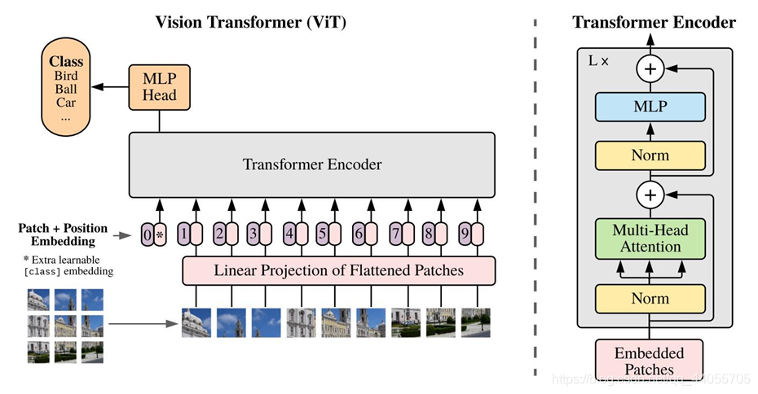
Introduction – Vision Transformers
Vision Transformers
Swin Transformers
NTUST GAMELab
Notes:
non-hierarchical
如何將Vit結合FPN

Slide 7
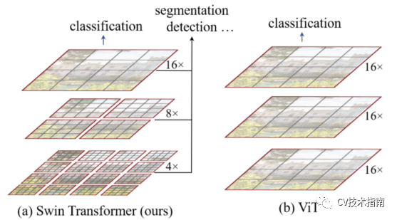
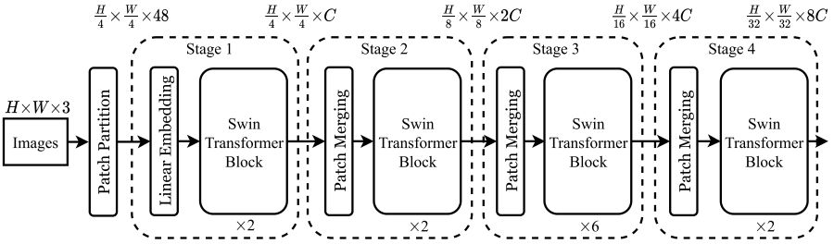
Introduction – Swin
NTUST GAMELab

Slide 8
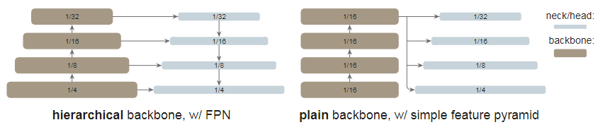
Introduction – Target
Use plain, non-hierarchical backbones. (Vision Transformers )
Independence of upstream vs. downstream tasks.
Use a simple feature pyramid.
Use Masked Autoencoder (MAE) pretraining.
Compete with the hierarchical-backbone detectors. (Swin, MViT)
NTUST GAMELab
Notes:
2. Like ConvNet-based research

Slide 9
Related Work
NTUST GAMELab

Slide 10
Related Work - Object detector backbones
Pioneered by the work of R-CNN.
SSD is the first works that leverage the hierarchical nature of the ConvNet backbones (VGG).
FPN pushes this direction further by using all stages of a hierarchical backbone, approached by lateral and top-down connections.
ViT is a powerful alternative to standard ConvNets for image classification. (Swin , MViT , PVT , PiT)
NTUST GAMELab
Notes:
4.作者認為以Vit去取代主幹是可以輕易實現的

Slide 11
Results
NTUST GAMELab

Slide 12
報告完畢 THE END
謝謝 Thank You
NTUST GAMELab

